Slide 1
AMP®-Parkinson's Disease Progression Prediction
Data 255 - Team 6
Daisy Adhikari
Lohitha Vanteru
Mahe Jabeen Abdul
Pranavi Sandrugu

Slide 2
Table of contents
Introduction
03
05
07
01
Data Source
Results
02
04
06
08
Models
Problem Formulation
Related Work
Data Processing
Future Scope
Notes:
Slides 3-8 :Lohitha

Slide 3
Introduction
Parkinson's disease (PD) is the second most degenerative neurological disorder after Alzheimer's disease
According to the Parkinson's Foundation, around 10 million people worldwide are living with this disease, and around 90,000 Americans are diagnosed with Parkinson's disease every year.
The prevalence of Parkinson's disease increases with age, with the average age of onset being around 60 years.
The economic burden of Parkinson's disease is significant, with an estimated cost of $52 billion annually in the United States alone.

Slide 4
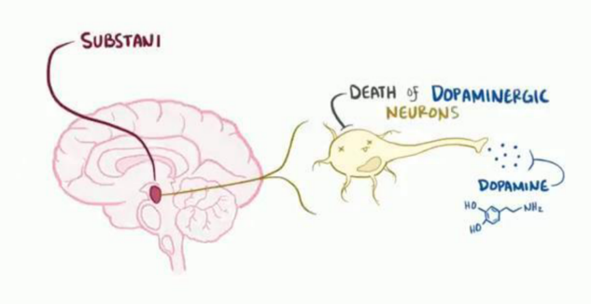
How does this happen and why?
Parkinson's disease is a neurodegenerative disorder that affects the central nervous system.
Caused by loss of dopamine-producing neurons in the region of the brain called the substantia nigra.
Diagnosis is typically made based on clinical symptoms, as there is currently no definitive test for Parkinson's disease.
Treatment options include medications that replace or increase dopamine levels, deep brain stimulation, lifestyle changes and physical therapy.
While there is no cure for Parkinson's disease, early diagnosis and treatment can improve quality of life and slow the progression of symptoms.
https://www.osmosis.org/learn/Parkinson_disease

Slide 5
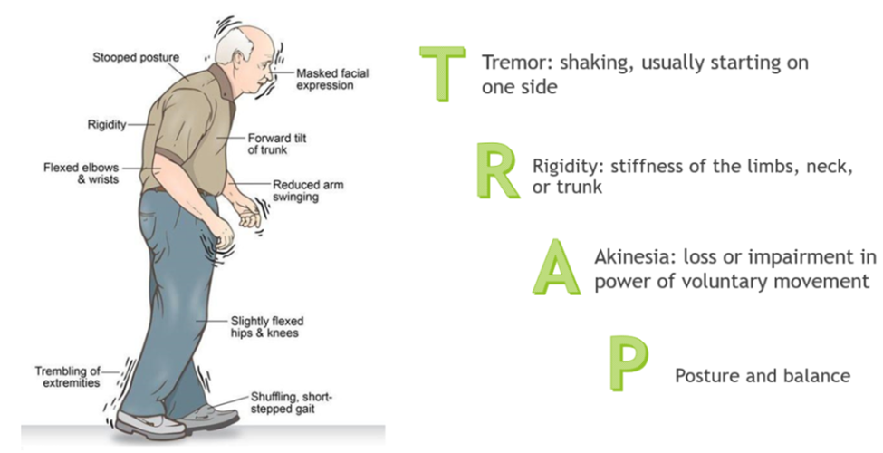
Two types of symptoms
Motor Symptoms
Tremors, rigidity, and impaired balance and coordination
Non-motor Symptoms
Cognitive impairment, sleep disturbances, and depression
https://drbriananderson.com/parkinsons-disease-balance-disorders/

Slide 6
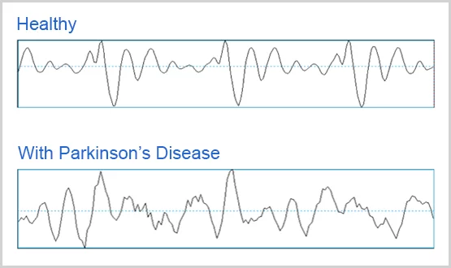
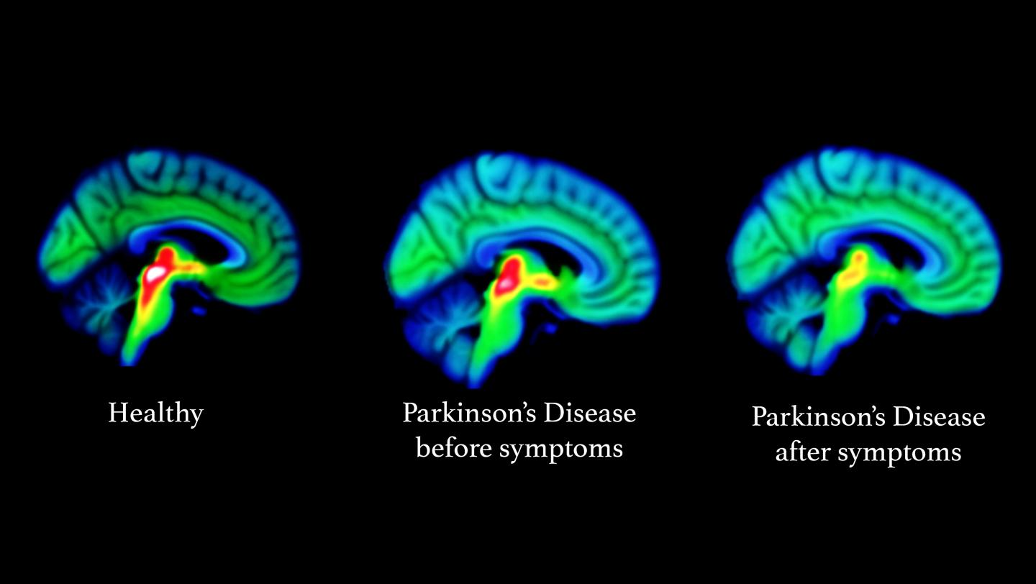
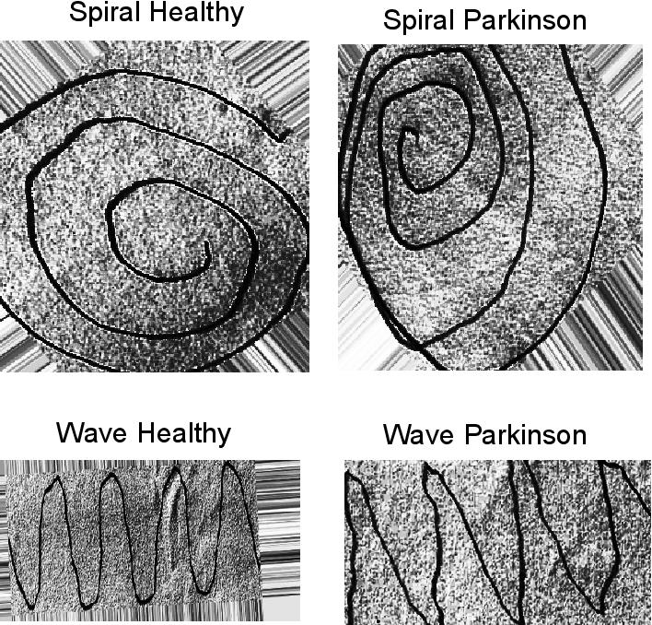
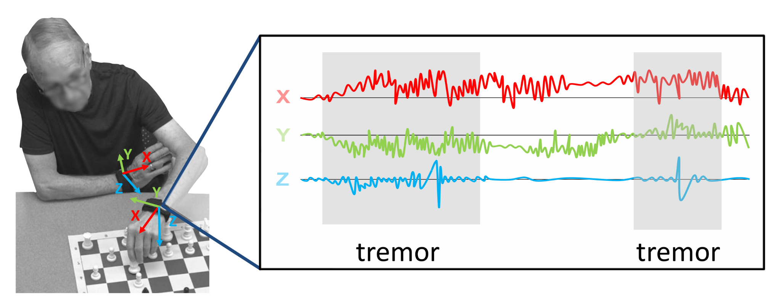
Related Work
Study | Data Modality | Method
Das, 2010 | Voice | Discriminate healthy people from those with PD by 92.9% classiﬁcation accuracy using neural networks.
Choi et al., 2017 | Brain scan images | Help imaging diagnosis of patients with uncertain Parkinsonism, especially for those with missing dopamine levels using Deep CNN.
Pereira et al., 2018 | Handwritten patterns | Diagnosis of PD based on the patient's trace and the exam template using SVM classifier with the RBF kernel for 85.54% accuracy.
Pardoel S et al., 2019 | wearable sensors | Proposed SE-DeepConvNet, a compact deep convolutional neural network including squeeze-and-excite components for fog detection, receiving a score of 95.66%
https:/

Slide 7
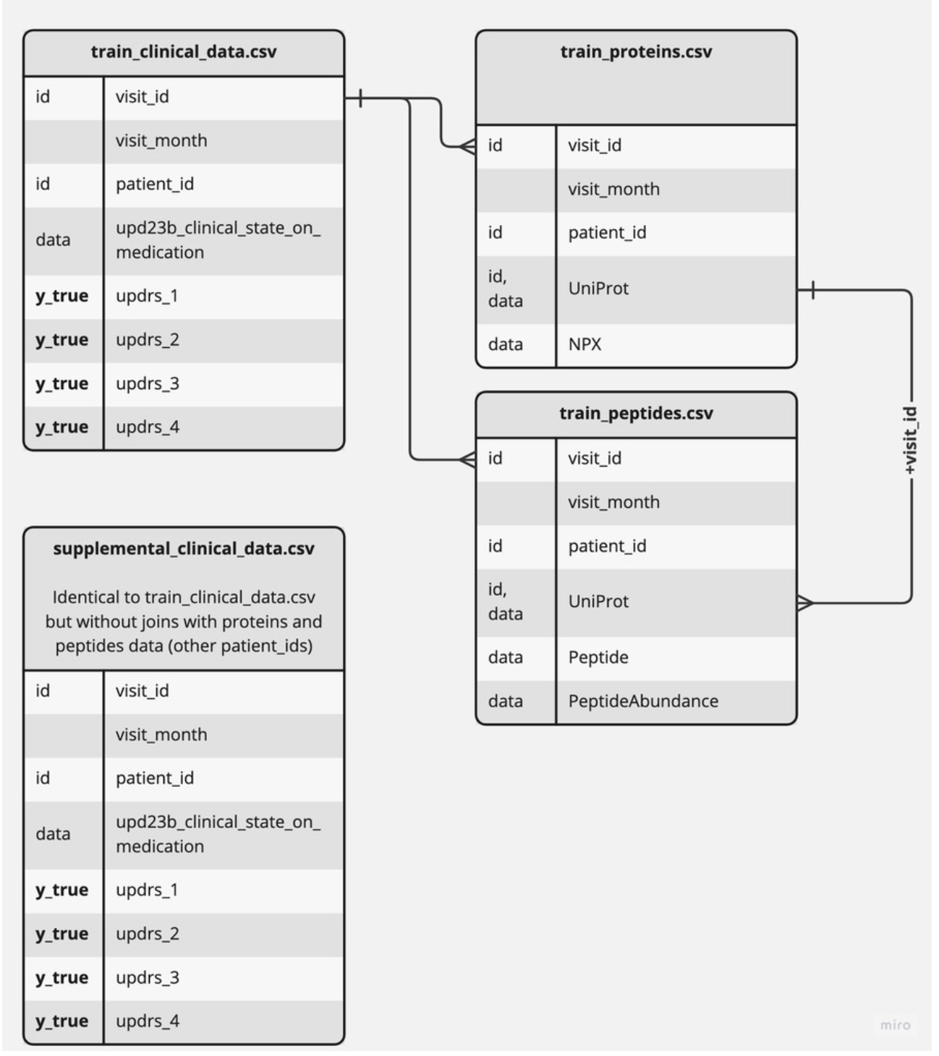
Data Sources
The data for the current study was provided by Accelerating Medicines Partnership® Parkinson’s Disease (AMP®PD), a public-private partnership between government, industry, and nonprofits that is managed through the Foundation of the National Institutes of Health (FNIH)
Training Data is comprised of following files:
train_peptides.csv :Mass spectrometry data at the peptide level
train_proteins.csv: Protein expression frequencies aggregated from the peptide level data.
train_clinical_data.csv: Clinical records to monitor the progression of disease
supplemental_clinical_data.csv : Clinical records without any associated CSF samples
https://www.kaggle.com/code/vitalykudelya/explain-dataset-test-api-cross-validation-tips/notebook
Notes:
The cerebrospinal fluid (CBF) samples taken from several hundred patients make up the main dataset, which comprises protein abundance measurements obtained from mass spectrometry analysis.
This information is meant to give further background on how Parkinson's disease typically progresses. similar columns to train_clinical_data.csv are used.

Slide 8
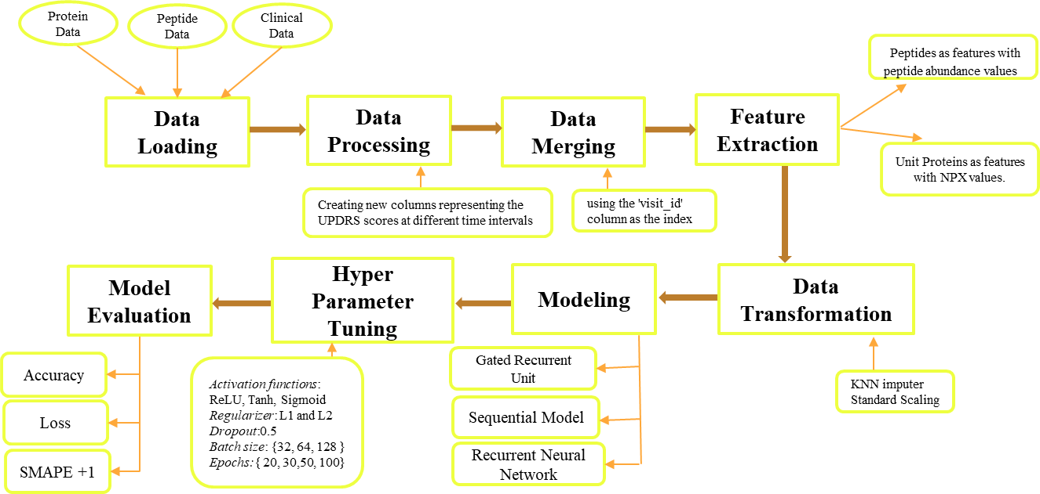
Project Architecture

Slide 9
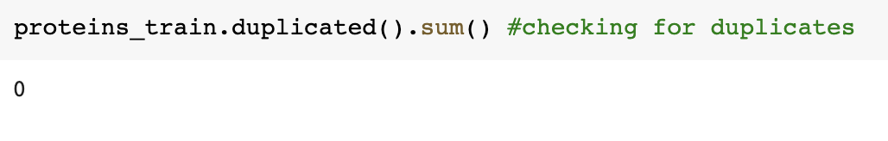
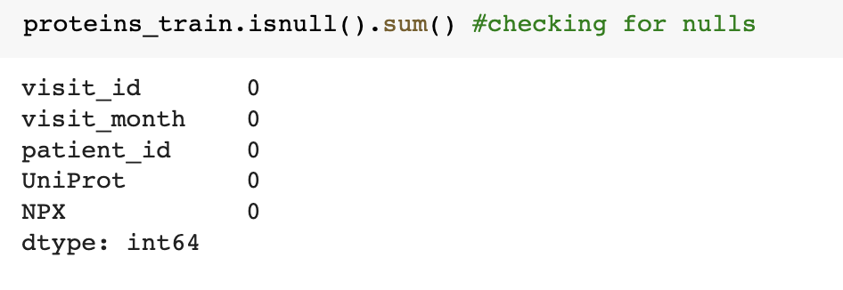
Data Cleaning and Feature Extraction
Data cleaning includes checking for missing values, duplicated data, or incorrect data from the dataset. It also includes removing or imputing missing values and duplicates.
The model uses two different feature extraction methods from the input data.
One method uses peptides as features with peptide abundance values from train_peptides.csv.
Another method uses Unit Protein from train_proteins.csv as features and uses its NPX values.

Slide 10
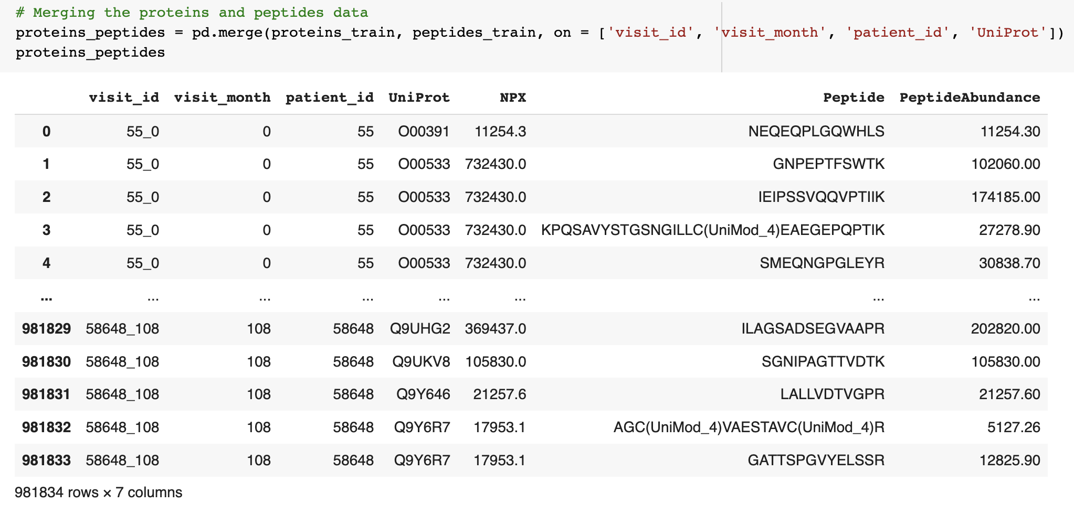
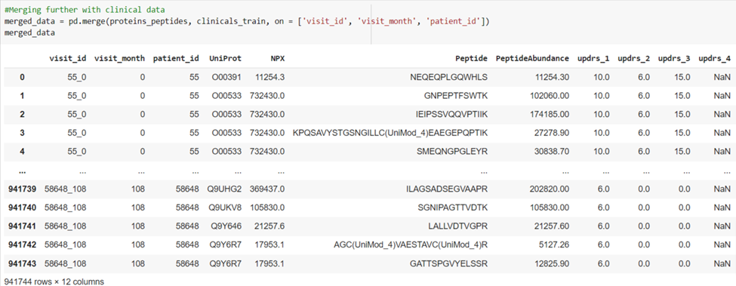
Data Merging
We have merged two datasets, proteins_train, and peptides_train, into a single dataset called proteins_peptides based on four columns: 'visit_id,' 'visit_month,' 'patient_id,' and 'UniProt.'
Furthermore, we have merged the dataset, proteins_peptides, with the clinicals_train dataset, based on three columns: 'visit_id,' 'visit_month,' and 'patient_id.'

Slide 11
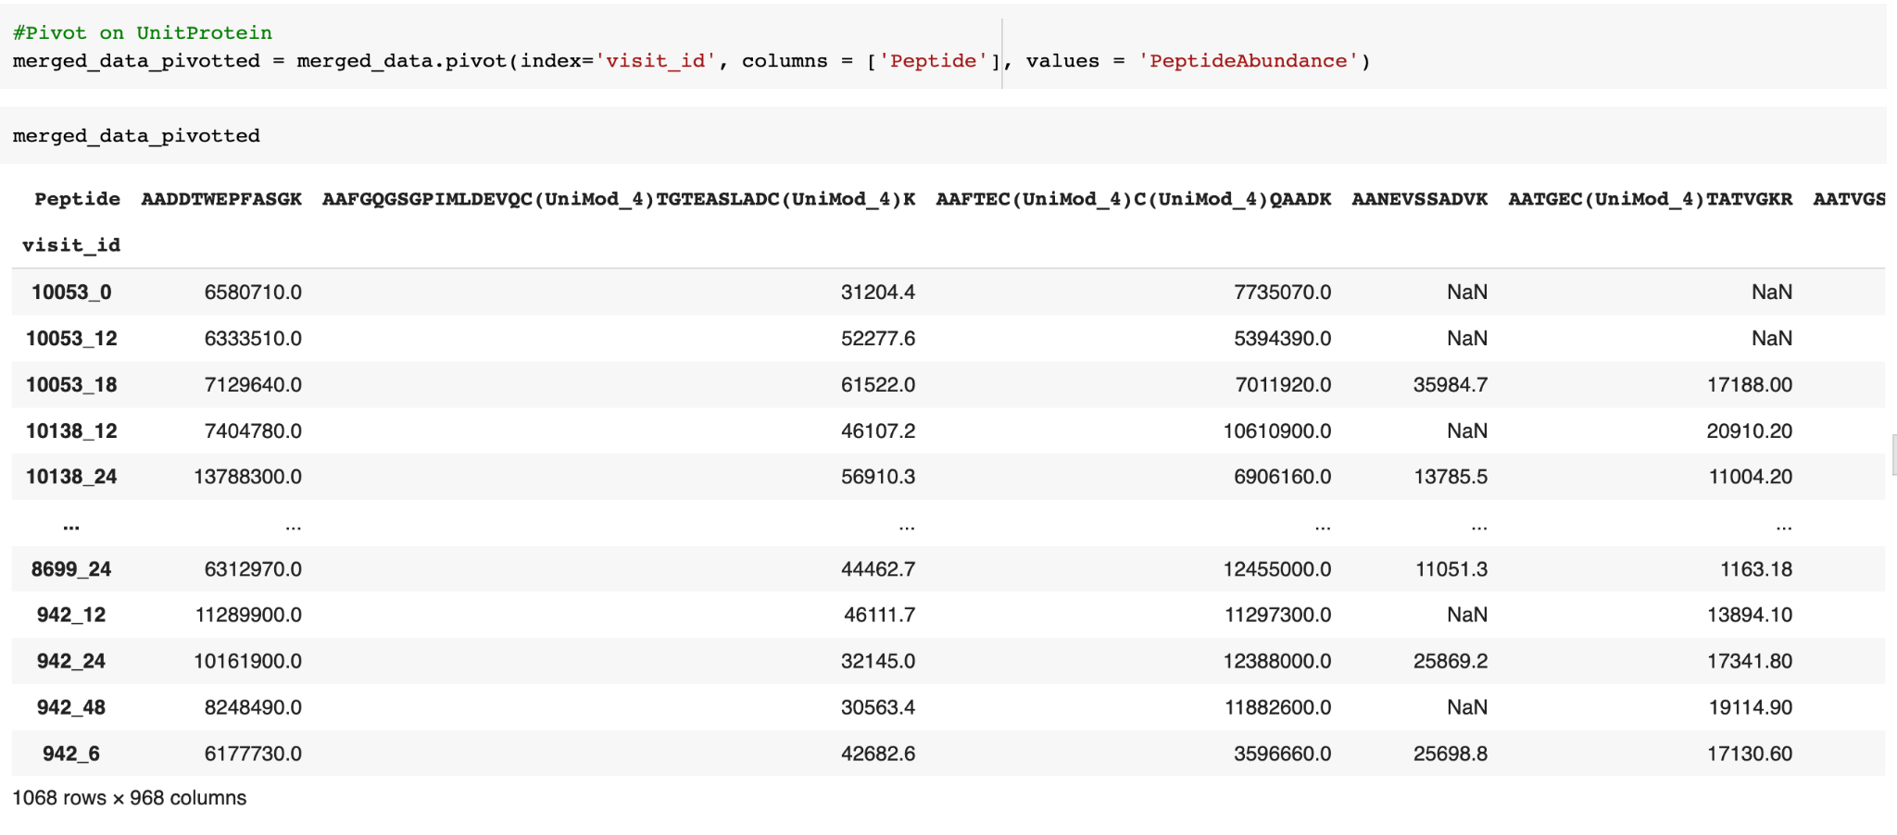
Data Transformation
We have used pivot on the merged_data dataset on the UniProt column, with the Peptide column as the new column headers and the Peptide abundance column as the new values.

Slide 12
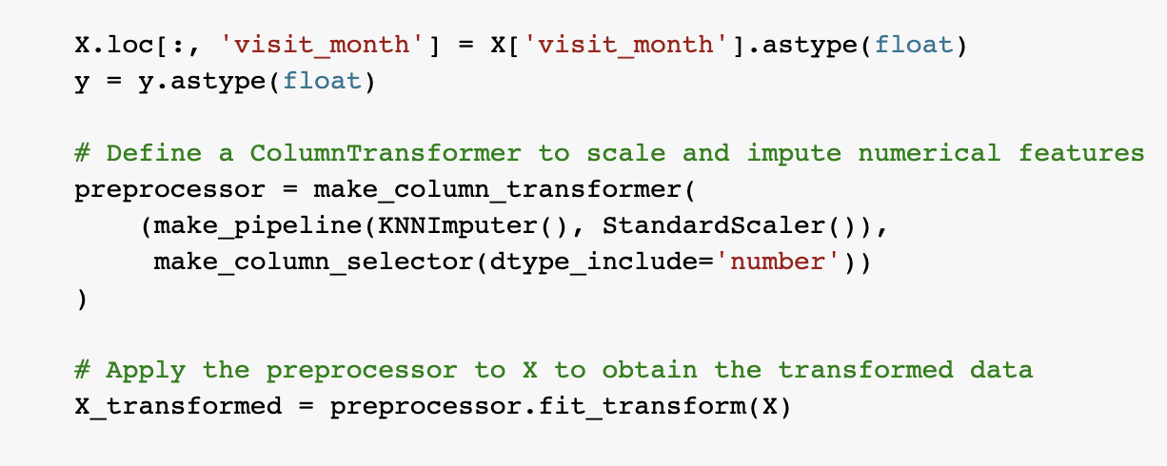
Data Transformation
The feature matrix 'X' is transformed using a column transformer
that applies KNN imputation and standard scaling to the numerical features. This results in a
transformed feature matrix 'X_transformed', which is used to train the model.

Slide 13
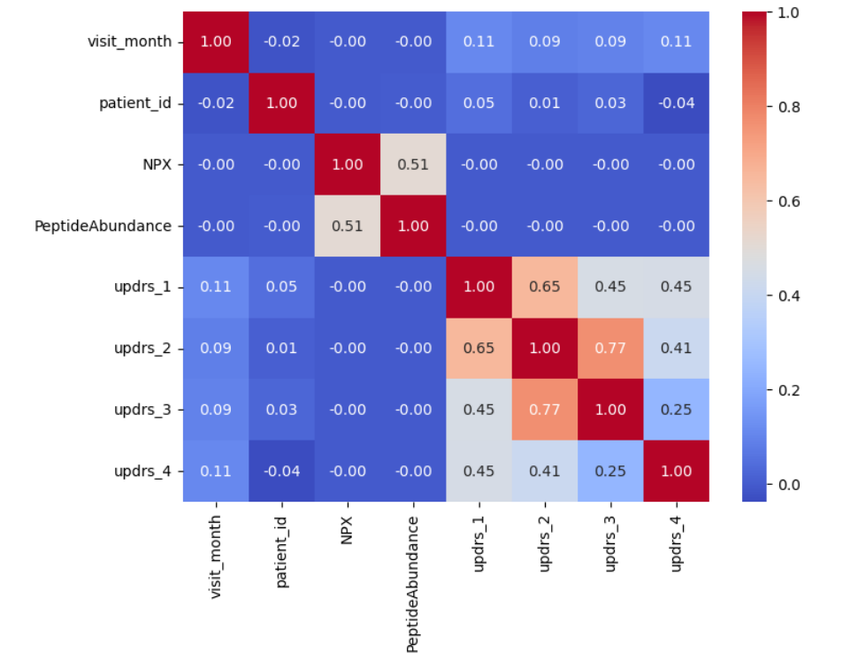
Data Visualization
Heatmap
Heatmap is created to help visualize the correlation between the numerical features in the merged_data Dataset
We can see that the columns updrs_2 and updrs_3 and updrs_1 and updrs_2 are highly correlated with each other compared to the other features. Furthermore, we cannot see any correlation between the other columns in the dataset, in which some have no correlation or are negatively correlated.

Slide 14
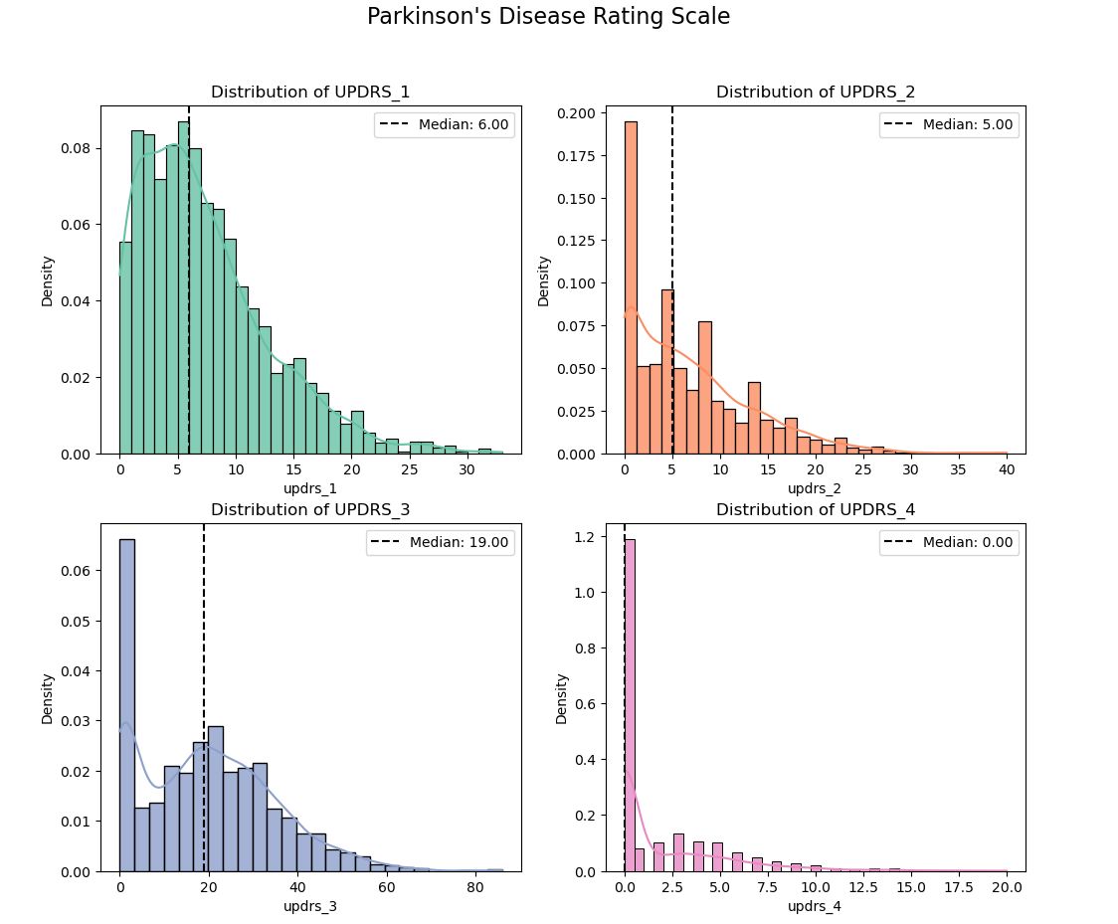
Data Visualization
Parkinson’s Disease Rating Scale
Data Visualization
We can see that the plots are highly skewed, and most of the data lies in the left part of the plot.
The plots visualize the distribution of the Parkinson's Disease Rating Scale scores for each of the updrs[1-4] features.

Slide 15
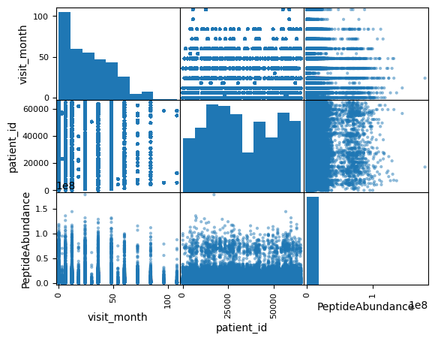
Data Visualization
Scatter plot
Scatter plot is created to understand the visual representation of the data for the proteins_train dataset, to observe the relationship between the variables.

Slide 16
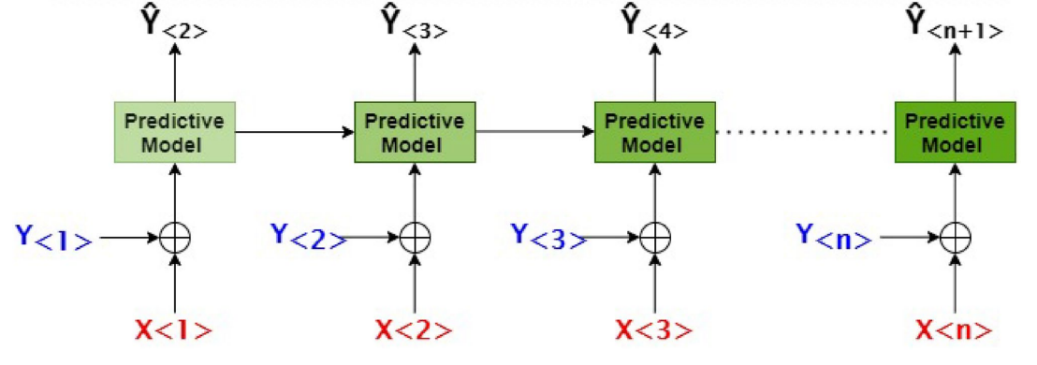
Problem Formulation
The issue is modeled in such a way that, when a patient's Baseline year (the first year) protein data is sent to the predictive model, it predicts the patient's MDS-UPDRS score for the next year, in order to understand the patient's status.
When the baseline year and the next year's protein data are used as input, the model predicts the consecutive year's MDS-UPDRS score.
To forecast the MDS-UPDRS score of the (N+1)th visit, we input the model with the the MDS-UPDRS score of the Nth visit as well as the scores of all the prior visits (N-1)th, (N-2)th,..., 1st.

Slide 17
Models and Justification
Model | Justification
RNN | RNNs are effective in modeling sequential data and capturing temporal dependencies, making them suitable for Parkinson's disease prediction when the data contains features that change over time or are related to the progression of the disease.
GRU | GRUs address the vanishing gradient problem in RNNs by using gating mechanisms, allowing them to learn long-term dependencies more effectively. They are useful in Parkinson's disease prediction when the data contains long-term patterns or when the progression of the disease is influenced by factors over an extended period.
Dense NN | Dense NNs can efficiently learn relationships between input features such as Peptides in this case and provide accurate predictions. Furthermore, they are relatively simple to implement and train.
Notes:
Daisy:

Slide 18
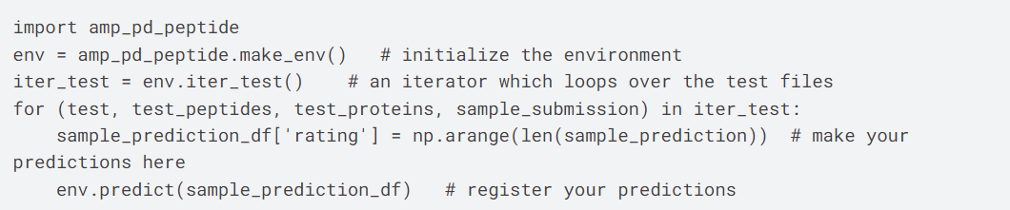
Model Evaluation
To ensure fairness and prevent time leakage, Kaggle requires to use the provided Python time-series API for submitting the solutions.
The API ensures that models do not access any future data during the training or prediction phases.
Below is the snippet of the code which is intended to be used as a starting point for making predictions on the AMP-PD Peptide dataset and submitting them to the competition.
Notes:
Daisy

Slide 19
Model Evaluation
The goal of the competition is to predict UPDRS scores for patients with Parkinson's disease at different time points based on protein/peptide samples.
The accuracy of the predictions will be evaluated using the Symmetric Mean Absolute Percentage Error (SMAPE) metric.
The SMAPE metric measures the percentage difference between the actual and predicted values, and is calculated as follows:
SMAPE = (1/n) * ∑(|Ft - At| / ((|Ft| + |At|)/2)) * 100
For each patient visit where a protein/peptide sample was taken, the goal is to estimate the patient's UPDRS scores for that visit, as well as predict their scores for potential visits 6, 12, and 24 months later.
Notes:
Daisy

Slide 20
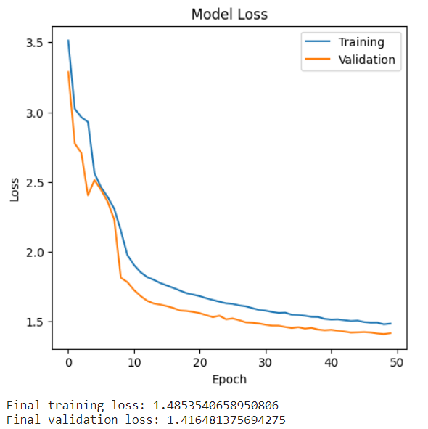
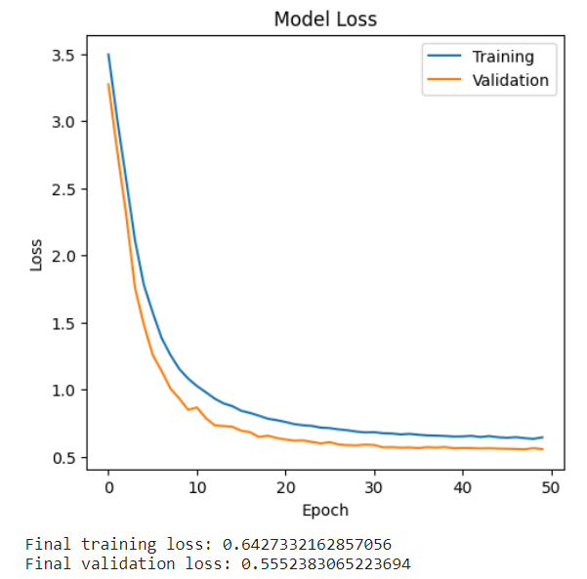
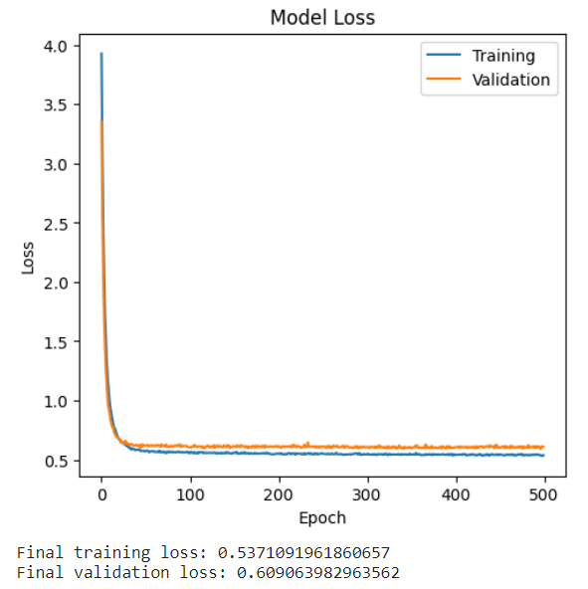
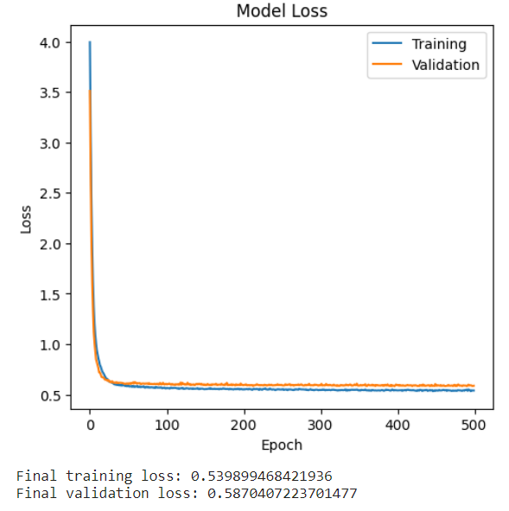
Result Analysis
 | Using Peptides as Features | Using UnitProt as Features
GRU
Deep NN
Notes:
Daisy: The plots show the the model loss (training and validation). These plots help visualize the model's performance and convergence during training. The x-axis represents the number of epochs, and the y-axis represents the loss.

Slide 21
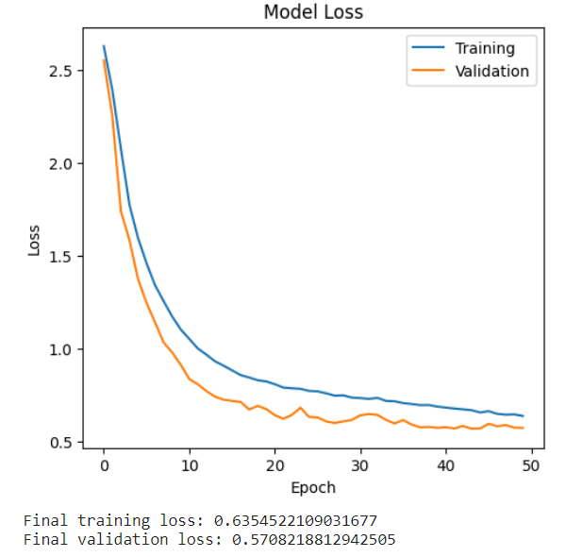
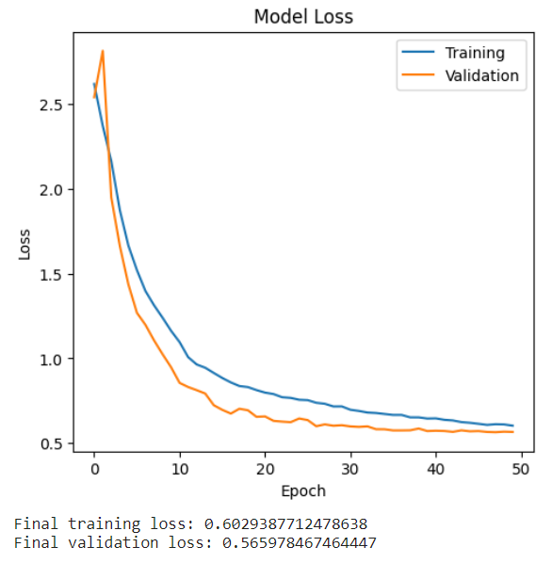
Result Analysis
 | Using Peptides as Features | Using UnitProt as Features
RNN
Notes:
Daisy

Slide 22

Project Management
The Trello project management tool was used to manage our project, which follows a kanban approach and can be adapted to different teams and projects.
Notes:
We have followed agile project management methodology using Trello project management tool to manage our project.

Slide 23
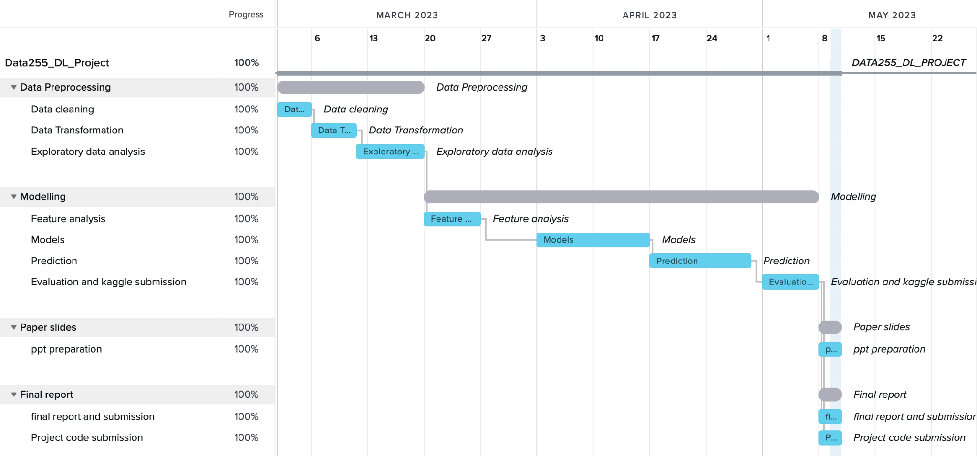
Project Management
The Gantt chart for our project was created using TeamGantt.

Slide 24

Ranking
Current Leaderboard Rank: 258 out of 1698 teams in the Competition.
Top 16 percent of the total teams.

Slide 25
Future Scope
The accuracy of the UPDRS score predictions can be enhanced by including more types of data in the current model, such as genetic or imaging data.
The model can be altered to forecast the likelihood that a patient's disease would worsen based on their present UPDRS scores and other pertinent details like age and drug usage.
A bigger patient sample can be used to test the model's performance in clinical situations and increase its generalizability. To enhance the performance of the model, the usage of transfer learning and ensembling approaches can be investigated.
The model can also be included into clinical decision support systems to help doctors decide what treatments to provide Parkinson's disease patients.
In order to create a more thorough strategy for anticipating disease development and patient outcomes, the project can be expanded to include other neurodegenerative illnesses like Alzheimer's disease or Huntington's disease.

Slide 26

Thank You!

Slide 27
References
Das, Resul. (2010). Das, R.: A comparison of multiple classification methods for diagnosis of Parkinson disease. Expert Systems with Applications 37, 1568-1572. Expert Systems with Applications. 37. 1568-1572. 10.1016/j.eswa.2009.06.040.
Choi H, Ha S, Im HJ, Paek SH, Lee DS. Refining diagnosis of Parkinson's disease with deep learning-based interpretation of dopamine transporter imaging. Neuroimage Clin. 2017 Sep 10;16:586-594. doi: 10.1016/j.nicl.2017.09.010. PMID: 28971009; PMCID: PMC5610036.
de Souza JWM, Alves SSA, Rebouças ES, Almeida JS, Rebouças Filho PP. A New Approach to Diagnose Parkinson's Disease Using a Structural Co-occurrence Matrix for a Similarity Analysis. Comput Intell Neurosci. 2018 Apr 24;2018:7613282. doi: 10.1155/2018/7613282. PMID: 29853835; PMCID: PMC5941776.
Pardoel S, Kofman J, Nantel J, Lemaire ED. Wearable-Sensor-based Detection and Prediction of Freezing of Gait in Parkinson's Disease: A Review. Sensors (Basel). 2019 Nov 24;19(23):5141. doi: 10.3390/s19235141. PMID: 31771246; PMCID: PMC6928783.

